Slide 1
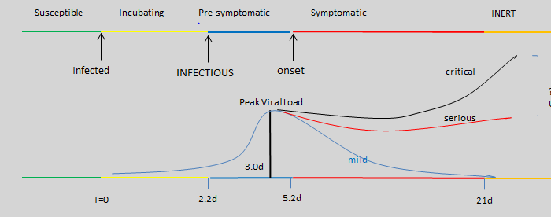
T.today today
T.sample date sample taken
T.report date reported
T.onset if known
Xi, He viral temporal dynamics model Nature Medicine rev. Aug 7, 2020
10% infections are before T.onset-3 days, so let’s use 4 days
Virus undetectable at T.onset+10

Slide 2

Efficient MHSU Risk Cohort Identification
MHSU DB
Positive
T.onset may be
known
Range.low
Range.high
T.today
Facility 1
Facility 2
Facility 3
Positive
Cases
DB
Rapid Test +PCR,
Self Isolate for interval

